Slide 1
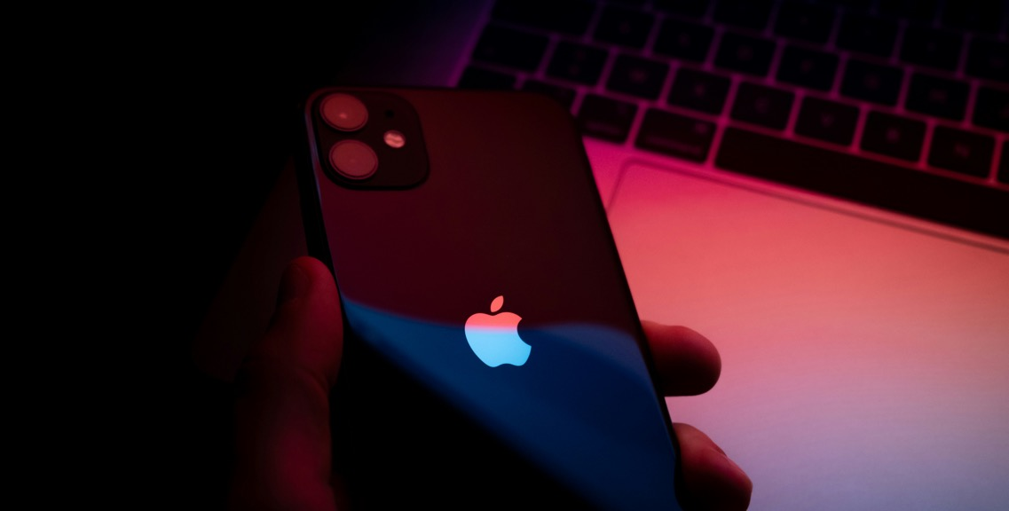
Crafting Compelling Web Presences
Darwin S

Slide 2

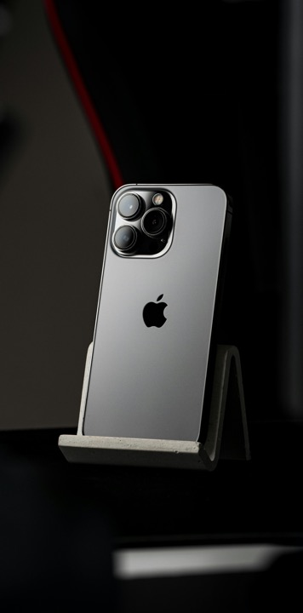
AGENDA
Products
Website Platforms
Design
Mistakes
Development
My Page

Slide 3


INTRODUCTION
Welcome to our presentation on the Apple website, a digital gateway to a world of innovation, style, and cutting-edge technology.
In the next few slides, we will delve into the design philosophy, key features, and user experience that make the Apple website a benchmark in the realm of online presence.

Slide 4

Products

Slide 5
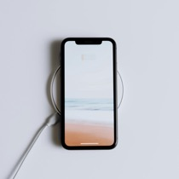

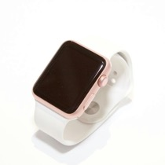
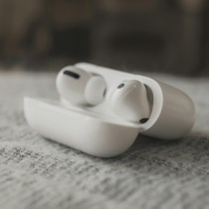
Products
Iphone
14
Iwatch
Airpods
Macbook
Air
Series SE
Pro
5

Slide 6
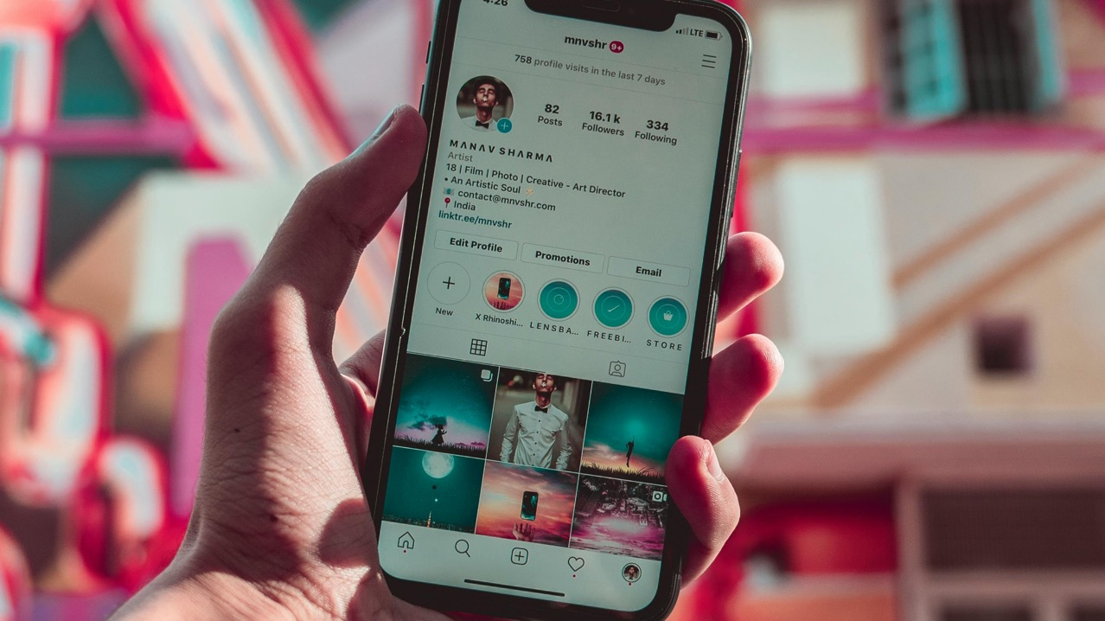
Iphone14

Slide 7
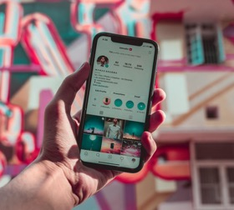
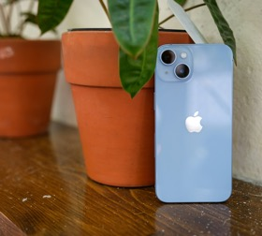
Hardware
The iPhone 14's A15 chip has a 6-core CPU, 5-core GPU, and a 16-core Neural Engine.
The iPhone 14 was the first flagship model since the 2008 iPhone 3G whose chip was unchanged from the previous year.

Slide 8
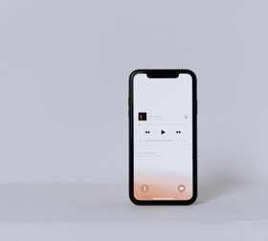
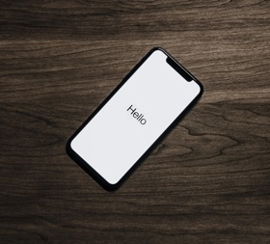
Display
The iPhone 14 features a 6.1-inch (155 mm) display with Super Retina XDR OLED technology at a resolution of 2532 × 1170 pixels and a pixel density of about 460 PPI with a refresh rate of 60 Hz.

Slide 9
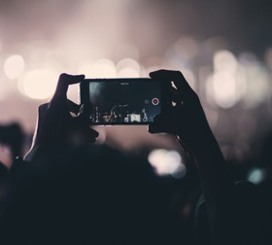
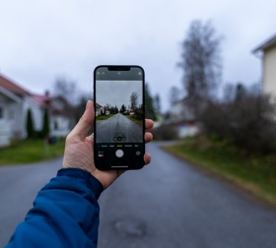
Camera
The iPhone 14 and 14 Plus feature the same camera system with two cameras: one front-facing camera (12MP f/1.9), and two back-facing cameras: a wide (12MP f/1.5) and ultra-wide (12MP f/2.4) camera, with the wide and front-facing cameras having a faster aperture than the iPhone 13. The front-facing camera also has autofocus for the first time.

Slide 10
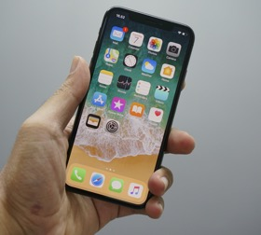
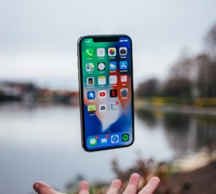
Storage
Phone 14 is available in three internal storage configurations: 128, 256, and 512 GB. Both models have 6 GB of RAM, an increase over the previous iPhone 13 and 13 mini models' 4 GB of RAM. The iPhone 14 have the IP68 rating for dust and water resistance as their predecessors.

Slide 11
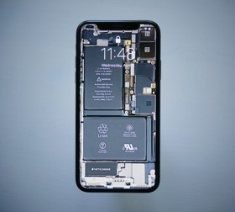
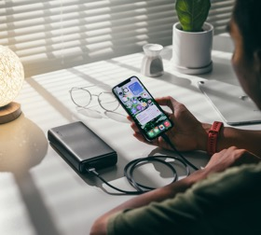
Battery
The iPhone 14 is equipped with slightly longer battery life compared to the iPhone 13. According to Apple, the iPhone 14 (3,279 mAh) can provide up to 20 hours of video playback,^{[36]} up to 16 hours of streaming video playback, and up to 80 hours of audio playback. Its predecessor, the iPhone 13 (3,240 mAh), is rated for up to 19 hours of video playback, 15 hours of streaming video playback, and 75 hours of audio playback.

Slide 12
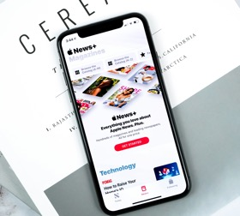
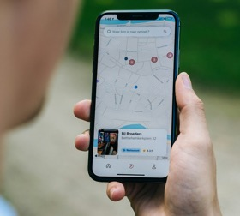
Software
The iPhone 14 originally shipped with iOS 16. The latest version of iOS, iOS 17, which was revealed at Apple's WWDC 2023 event, was released to the public on September 18, 2023, and is compatible with the iPhone 14 The next-generation Qi2 wireless charging standard has been added to the iPhone 14 with the update to iOS 17.2.

Slide 13
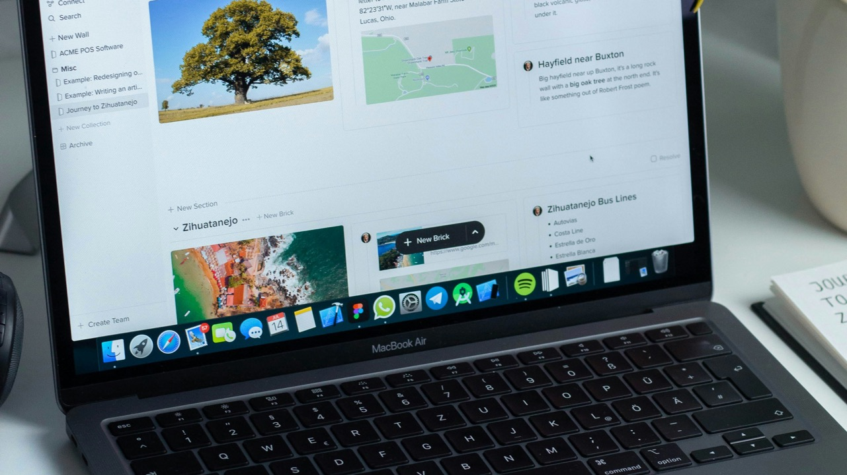
MacBook Air 15

Slide 14
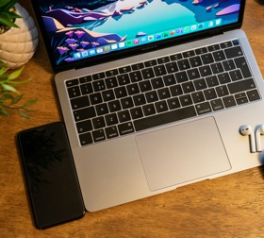
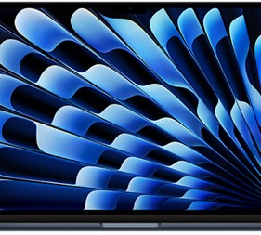
Chip
Apple M3 chip
8-core CPU with 4 performance cores and 4 efficiency cores
10-core GPU
Hardware-accelerated ray tracing
16-core Neural Engine
100GB/s memory bandwidth

Slide 15

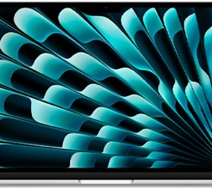
Display
Liquid Retina display
38.91 cm / 15.3″ (diagonal) LED-backlit display with IPS technology;¹ 2880x1864 native resolution at 224 pixels per inch
500 nits brightness
Colour
Support for 1 billion colours
Wide colour (P3)
True Tone technology

Slide 16


Memory
8GB Configurable to:
8GB unified memory 16GB or 24GB
16GB Configurable to:
16GB unified memory 24GB

Slide 17


Battery and Power
Up to 18 hours Apple TV app movie playback
Up to 15 hours wireless web
66.5-watt-hour lithium‑polymer battery
35W Dual USB-C Port Power Adapter
USB-C to MagSafe 3 Cable
Fast-charge capable with 70W USB-C Power Adapter

Slide 18
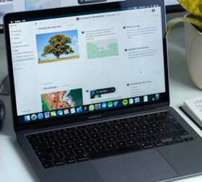
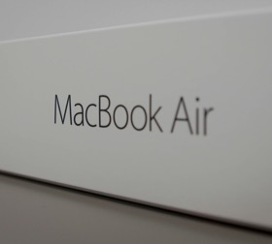
Storage
256GB Configurable to:
256GB SSD 512GB, 1TB or 2TB
512GB. Configurable to:
512GB SSD 1TB or 2TB

Slide 19
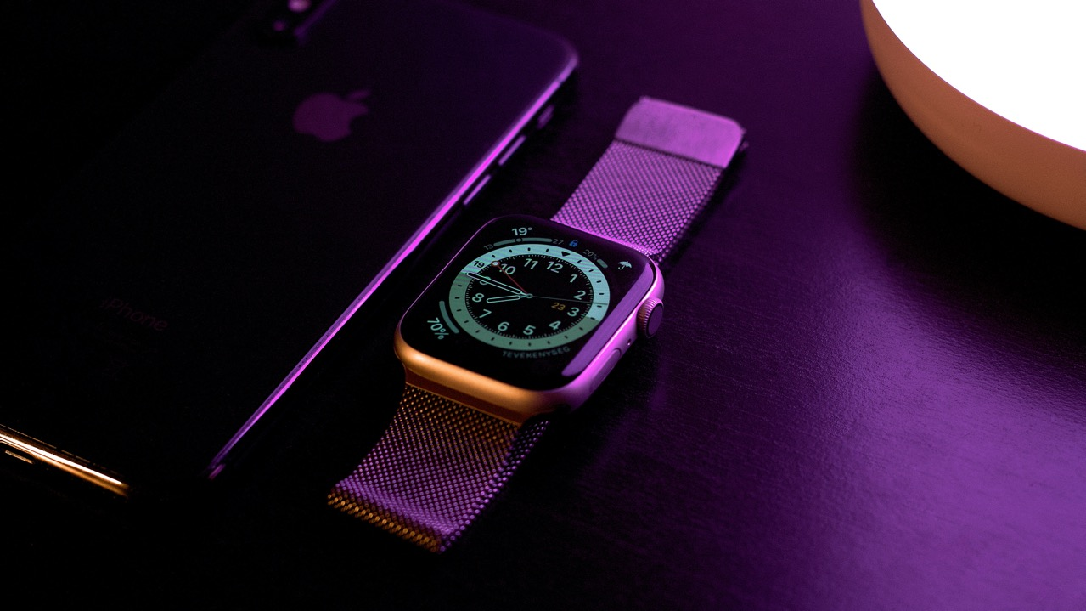
I watch SE
GPS + Cellular

Slide 20
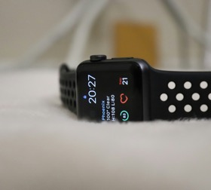
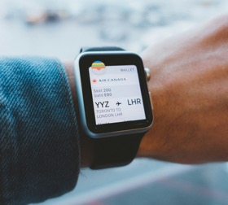
Iwatch SE
L1 GPS, GLONASS, Galileo, and QZSS
Compass
Always-on altimeter
Water resistant 50 meters²
Second-generation optical heart sensor
International emergency calling³
Emergency SOS¹
International roaming⁵

Slide 21
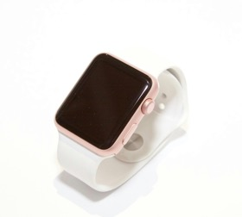
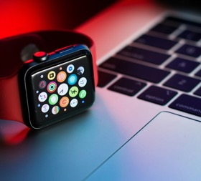
Display
44mm 368 by 448 pixels 977 sq mm display area
40mm 324 by 394 pixels 759 sq mm display area
etina LTPO OLED display Up to 1000 nits brightness

Slide 22
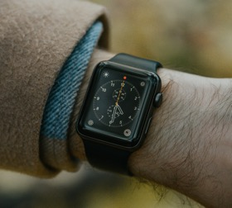
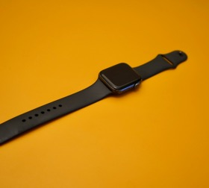
Chip
S8 SiP with 64-bit dual-core processor
W3 Apple wireless chip

Slide 23

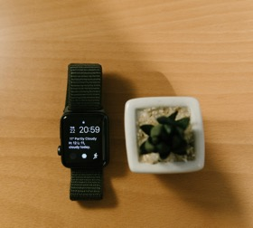
Power
Built-in rechargeable lithium-ion battery Up to 18 hours
USB-C magnetic charging cable

Slide 24
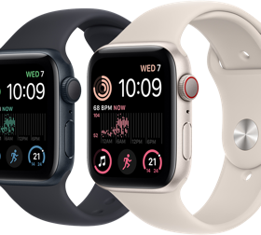
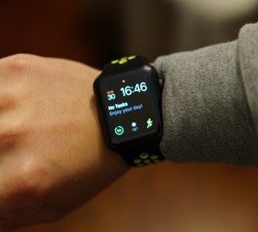
Connectivity
LTE and UMTS⁴ GPS + Cellular models Learn more about available carriers
Wi-Fi 4 802.11n
Bluetooth 5.3

Slide 25
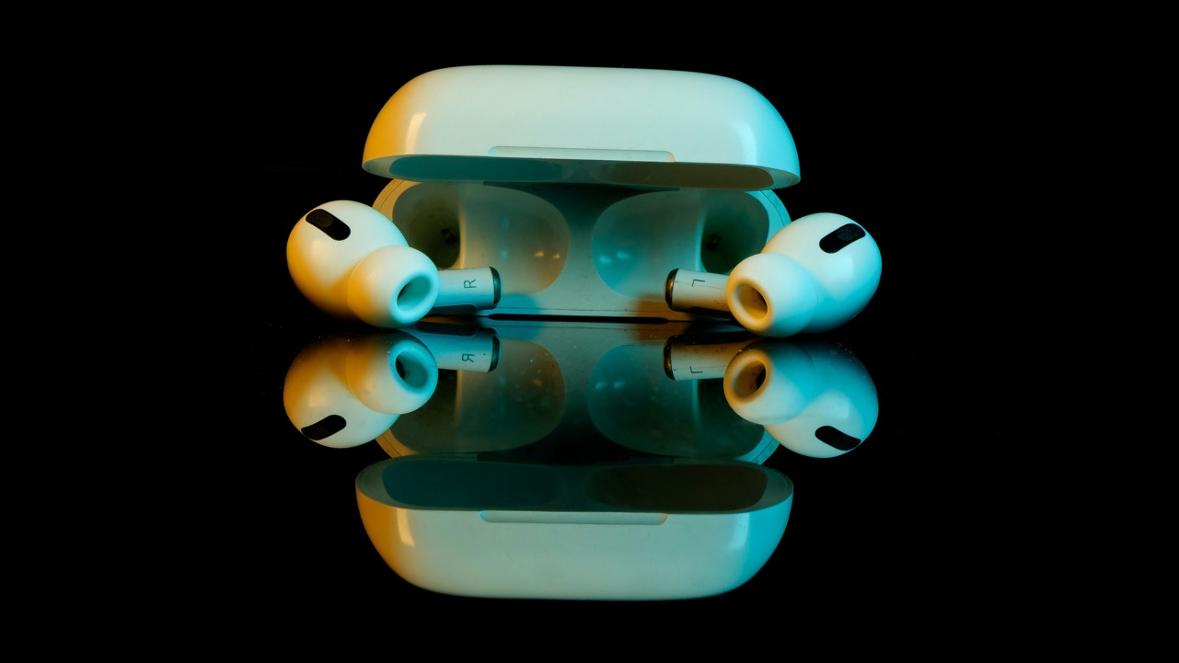
Air Pods Pro

Slide 26
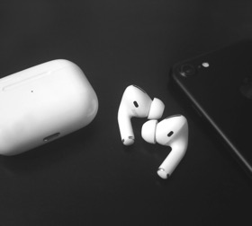
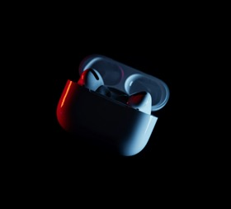
Audio Technology
Custom high-excursion Apple driver
Custom high dynamic range amplifier
Adaptive Audio¹
Active Noise Cancellation
Transparency mode
Conversation Awareness¹
Personalised Volume¹

Slide 27
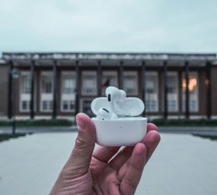
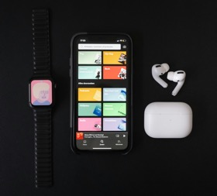
Sensor
Dual beamforming microphones
Inward-facing microphone
Skin-detect sensor
Motion-detecting accelerometer
Speech-detecting accelerometer
Touch control

Slide 28

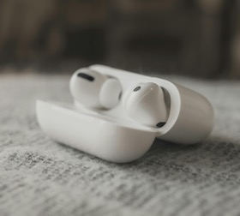
Chip
Apple H2 headphone chip
Apple U1 chip in MagSafe Charging Case (USB‑C)

Slide 29

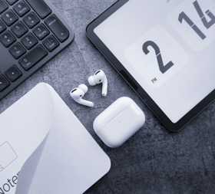
Charging Case
Works with MagSafe charger, Apple Watch charger, Qi-certified chargers or USB‑C connector

Slide 30
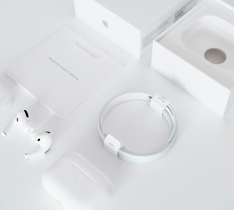
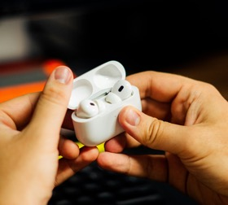
Battery
Up to 6 hours of listening time with a single charge (up to 5.5 hours with Spatial Audio and Head Tracking enabled)
Up to 4.5 hours of talk time with a single charge

Slide 31

Website Platform

Slide 32
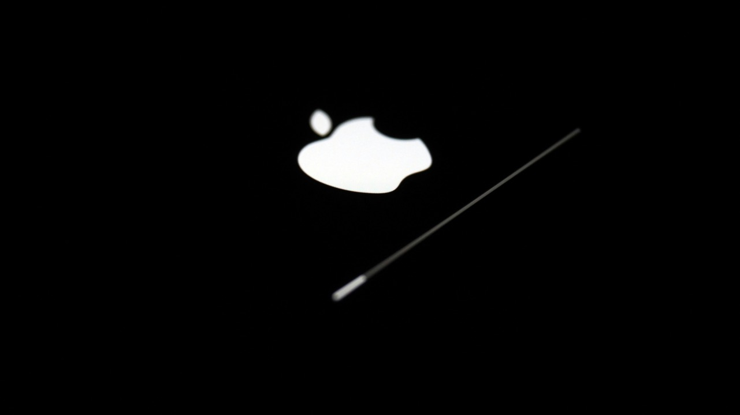
Analytics and Tracking

Slide 33
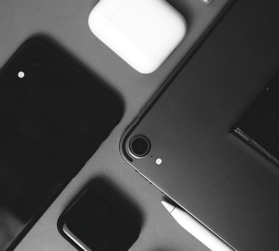
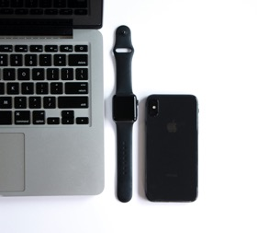
Omniture SiteCatalyst
Omniture SiteCatalyst is a tool that provides your website with actionable, real-time intelligence regarding online strategies and marketing initiatives.

Slide 34
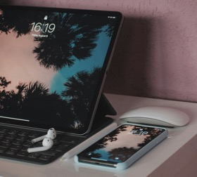
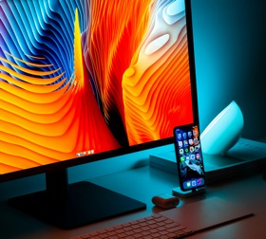
Adobe Marketing Cloud
Adobe Marketing Cloud is a comprehensive suite of marketing solutions by Adobe, offering tools for analytics, advertising, content management, and personalization. It enables businesses to optimize their digital marketing strategies, enhance customer experiences, and drive effective campaigns across various channels. The platform integrates data-driven insights to empower marketers in making informed decisions and achieving their marketing goals.

Slide 35

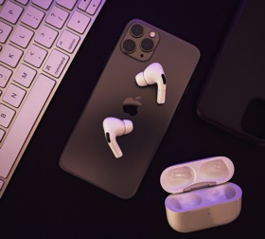
Dynatrace
Dynatrace provides software intelligence for enterprise cloud ecosystems. Dynatrace is an AI-powered, full stack and automated monitoring and analytics solution that provides insights into users, transactions, applications, and hybrid multi-cloud environments.

Slide 36

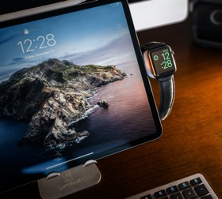
Adobe Analytic
Marketing analytics platform from Adobe

Slide 37

Widgets

Slide 38


Webex
Webex is a web conferencing and collaboration platform developed by Cisco. It facilitates online meetings, video conferences, and virtual collaboration, allowing participants to connect from different locations. With features like screen sharing, file sharing, and real-time communication, Webex enhances remote collaboration and team interactions. It is widely used for virtual meetings, webinars, and collaborative work across businesses and organizations.

Slide 39


Apple Whitelist
Whitelisting (allowlisting) is the process of securing your device or network by allowing trusted IP (Internet Protocol) addresses, software, or emails to access it. Whitelisting is a two-stage process of: Identifying trustworthy sources and agents; Granting them special recognition, access, and privileges.

Slide 40


Design

Slide 41


1280x1024 Resolution Home Page
In this website's homepage, when viewed on a viewport of 1280x1024 resolution and a monitor size of 15.4 inches, the website page appears fragmented and disorganized, resembling a collage of elements arranged in a grid-like manner.

Slide 42


1920x1080 Resolution Home Page
In this website's homepage, viewed at a viewport size of 1920x1080 on a 15.4-inch monitor, the products are not arranged closely; there is excessive space between each item.

Slide 43


1768x1024 Resolution Home Page
In this website's homepage, optimized for a viewport of 1768x1024 on a 15.4" monitor, specifically designed for their own product "iPad Mini," the page layout appears well-arranged. However, some minor issues persist, including the presence of an unwanted search bar in certain areas.

Slide 44


375x812 Resolution Accessories Page
In the accessories page of this website, when viewed at a viewport size of 375x812, on a 15.4" monitor, and on a 5.8" screen, the page layout is not arranged properly, and images are not displayed. Additionally, the page does not render correctly on other viewport sizes, monitor sizes (412x869, 768x1024, 1024x1366), or screen sizes (5.94", 7.9", 12.9").

Slide 45


1920x1080 Resolution Product Page
The iPhone page on the website appears distorted and incomplete when viewed at a viewport of 1920x1080 on a 15.4-inch monitor, despite it being Apple's own product. Images are not displaying properly, and the page layout is not arranged perfectly, making it difficult to view the content correctly.

Slide 46

mistakes

Slide 47


With a wide range of products and services, maintaining consistency in user experience across different sections of the website can be challenging. Inconsistencies in navigation, design elements, or terminology could confuse users. Even as an Apple product enthusiast, I find it difficult to choose and sometimes forget what I was looking for.

Slide 48


As mentioned earlier, certain elements or functionalities may not display optimally on all devices or screen sizes. Ensuring a seamless experience across desktop, tablet, and mobile devices is critical.

Slide 49

In this website, I've noticed that while modern browsers typically render websites accurately, minor inconsistencies or layout issues may arise on certain browsers or older versions. Ensuring compatibility across a range of browsers is essential. For example, when I used it on Windows 7, iOS X, and some older Android versions, it didn't work properly.

Slide 50


In this website, offering a wide range of products and services can make it challenging to maintain consistency in user experience across different sections. Inconsistencies in navigation, design elements, or terminology could confuse users. When compared to its competitor websites, they allocate it properly.

Slide 51

Ensuring accessibility for users with disabilities is crucial. Mistakes in this area could include insufficient contrast between text and background, lack of alternative text for images, or non-intuitive navigation. While all products are of the same color, they specify that one or two products do not look good.

Slide 52

ideas

Slide 53

My point on User Friendly Website
If we have only a few varieties, then we should give equal importance to each product on the website. This approach can improve growth.
In the website, each product's colors should be presented in a 360-degree view.
In websites, products like mobiles with operating features are more attractive.
Not all visitors are educated, so it's important that anyone visiting the page can easily find the products they're looking for.
Once visitors search for products, the product descriptions should be concise and easy to understand, avoiding deep technical details

Slide 54

My page
https://darwinstalinbabu24.wixsite.com/iphone-15

